Slide 1


DATA221 Intro Machine Learning 08 linear discrimination
William Trimble
Spring 2022

Slide 2
Office hours reminder

Slide 3
Linear discrimination
I want a linear function of X that will tell class 1 from class not-1.
Let us imagine that I infer probability densities for class 1 and class 2
And let us imagine that I use normal densities for my distribution of features in X.
What happens?

Slide 4
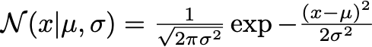
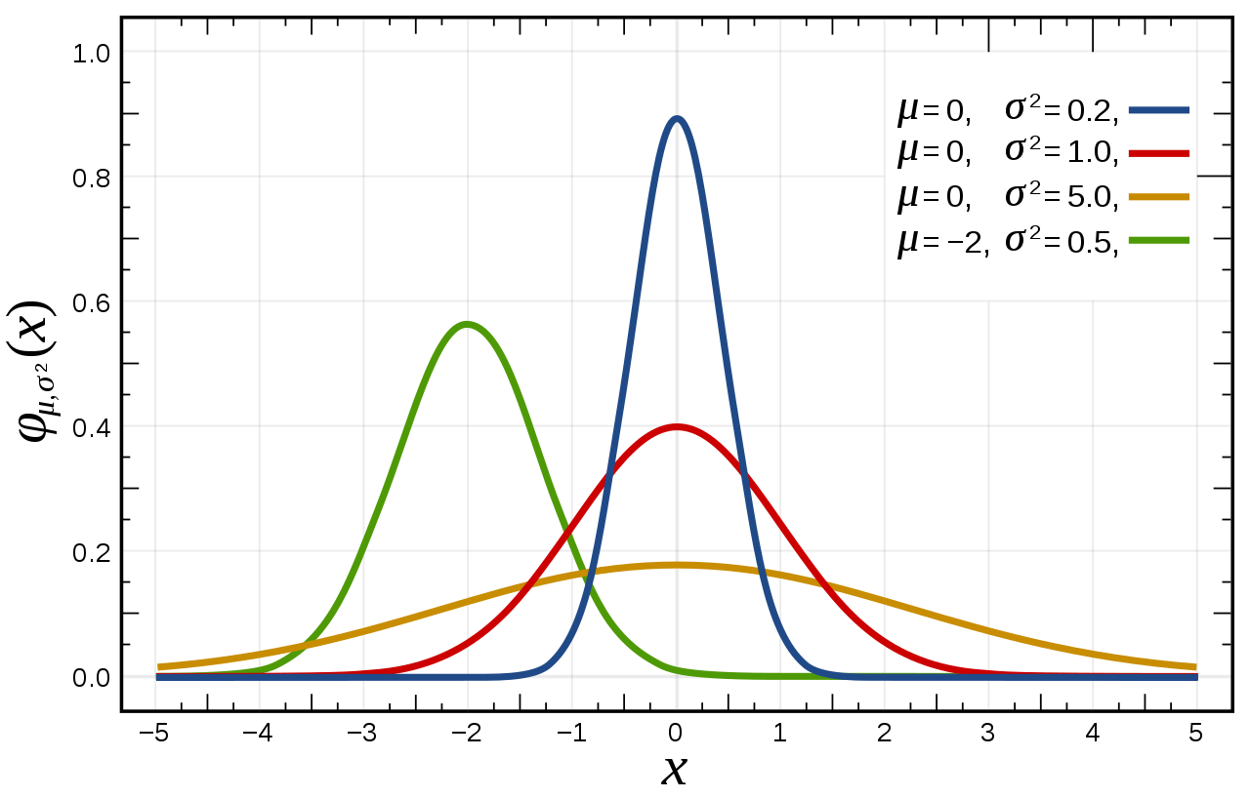
Anatomy of the normal distribution

Slide 5

Look at univariate Normal:
x² term gives me curvature
x and x² term gives me position
constant term gives me…
a multiplicative constant.

Slide 6


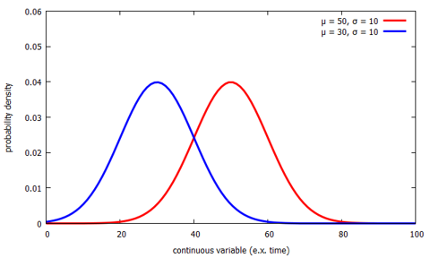
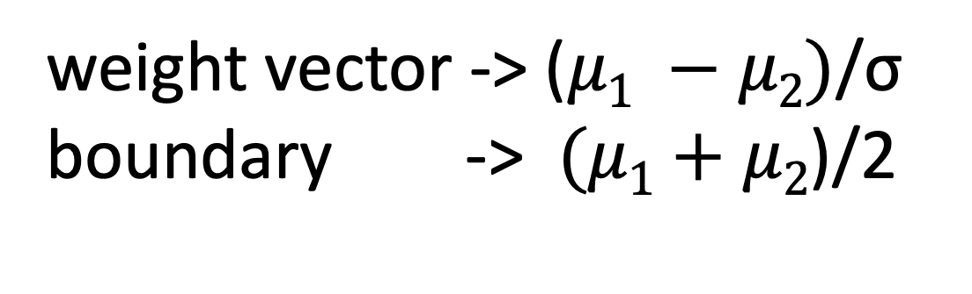
Boundary between two same-variance normal distributions in 1d…
Simple, but to get here I assumed:
equal weights to the two classes (prior)
equal variances for the classes
weight vector -> ($μ1 −$ $μ2)$/σ
boundary -> $(μ1+$ $μ2$)/2

Slide 7
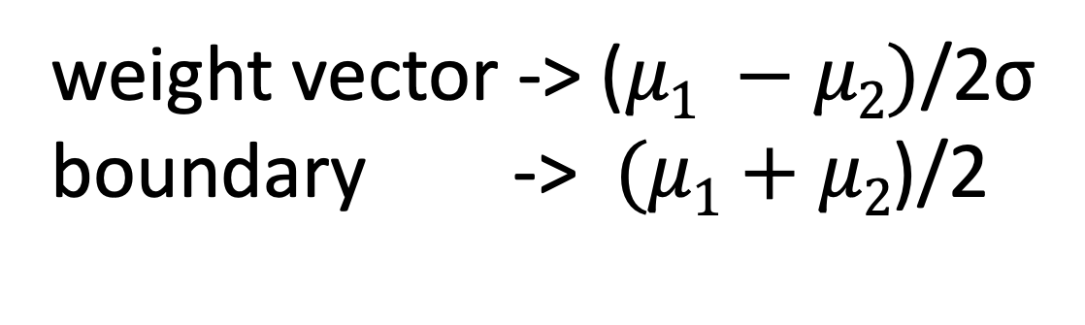
Boundary between two same-variance normal distributions in 1d…
Simple, but to get here I assumed:
equal weights to the two classes (prior)
equal variances for the classes
weight vector -> ($μ1 −$ $μ2)$/2σ
boundary -> $(μ1+$ $μ2$)/2

Slide 8
Why are we so eager to call everything normal?
Wasn’t there another class that warned us not to make normality assumptions without checking them?
“Englightened mathematical convenience”
Normal solves the problem of distribution with maximum entropy with constraints on mean and standard deviation
Estimating the parameters of the normal distribution (sample mean and sample standard deviation) does not require optimization
With enough degrees of freedom, everything looks like a sum of normals.

Slide 9
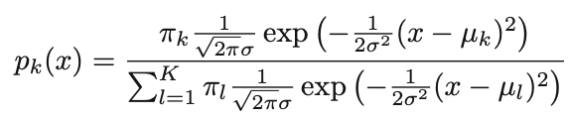

In one dimension, if I have k classes, each with a different $μ$…
Assumption of normal distribution for each class + Bayes’ rule
When would you have k classes in 1 dimension?
Growth curves.

Slide 10
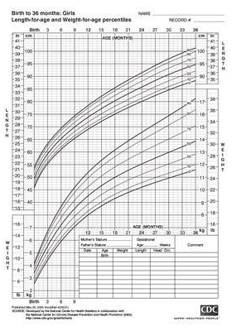
Height
Weight
Age (0-3 years)

Slide 11
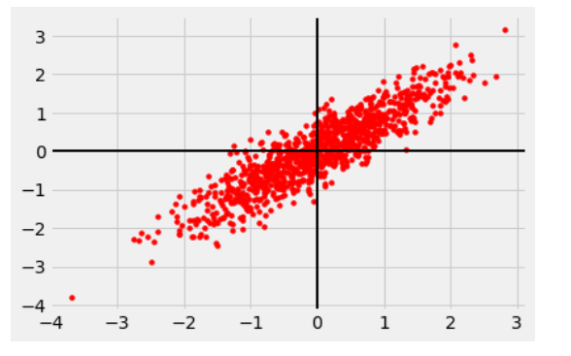

Multivariate normal
Σ covariance matrix
Σ⁻¹ “precision” matrix
Keep track of x₀ and Σ for each class…
What if we just let all the Σ be the same?

Slide 12
Multivariate normal
Σ covariance matrix
Σ⁻¹ “precision” matrix
Keep track of x₀ and Σ for each class…
What if we just let all the Σ be the same?
Why? To make things easier on us…

Slide 13
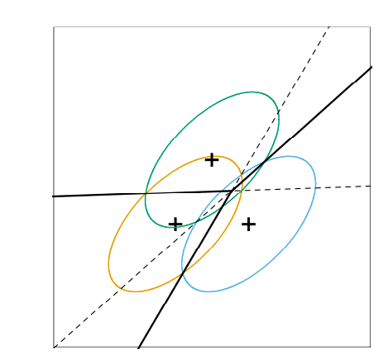
Linear Discriminant Analysis
When all the classes have the same covariance matrix Σ, the quadratic terms in the decision boundaries drop out and you can get linear decision boundaries.

Slide 14
Shared covariance matrix Σ
If the classes share a covariance matrix, I get another benefit.
The square root of this quadratic form goes by the name
Mahalanobis distance

Slide 15
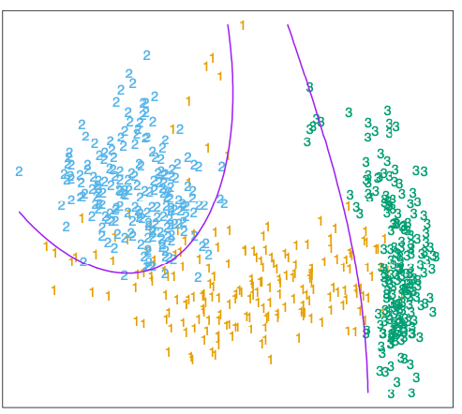
“Quadratic Discriminant Analysis”
When each class gets its own covariance matrix Σ, quadratic decision boundaries result.
This gives answers very close to logistic regression with x₁², x₂², and x₁x₂ terms.

Slide 16
Linear Discriminant Analysis
The old CS wizards say that when linear or quadratic classification work, they tend to work well, and capture most of what there is to be had.
There is a formulation of linear discriminant analysis that gives essentially the same results from the early 20th century credited to Ronald Fisher. Engineered for pen-and-paper calculation, it compares within-group variance to between-group variance and optimizes the weight vectors for that ratio.

Slide 17
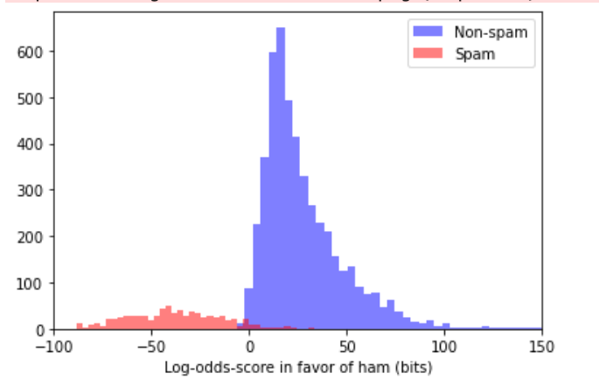

Slide 18
